Slide 1
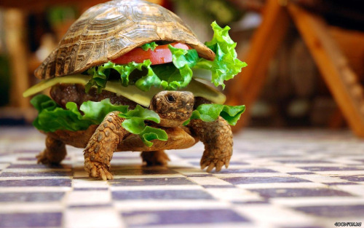
Social benefits of slow food
Group 4 Project Katarina, Kirana, Adrien, Cyril, Thibaud

Slide 2
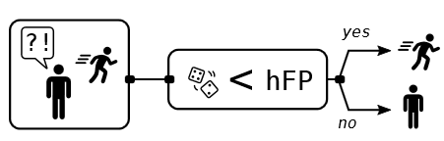
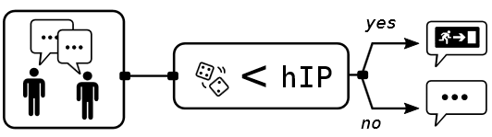
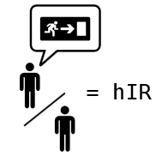
Question
Cooperation imply costs…
… what is the social benefit of cooperating against zombies?

Slide 3
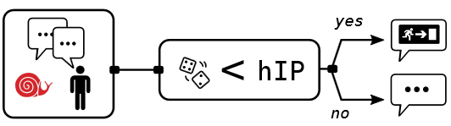



Question
Cooperation imply costs…
… what is the social benefit of cooperating against zombies?
hIp1 > hIp
hIp1
hRs = 0.49
= 0
= 1
hRs1 < hRs

Slide 4
Modification of the code
ScalaTask("""
import zombies._
val agents =
(0 until nbSlow).map(_ => Human(informProbability = hIp1, runSpeed = hRs1, informed=true))
val rng = Random(seed)
val result = zombieInvasion(
zombies = 4,
humans = 250 - nbSlow, // with default values
agents = agents,
steps = 500,
random = rng,
humanInformedRatio=0.0)
val rescuedDynamic = result.rescuedDynamic()
val rescuedDynamicSlow = result.filteredRescuedDynamic(runSpeed = Some(_ < 0.3))
val rescuedDynamicFast = result.filteredRescuedDynamic(runSpeed = Some(_ >= 0.3))
""")
Creation of slow food
Modified the informed agents
Three parameters to explore
Filtering of rescuedDynamic (thanks Romain!)

Slide 5

Exploration 1
Direct sampling
nbSlow in (0 to 125 by 25) (Number of )
hRs1 in (0.1 to 0.4 by 0.1) (Run speed of )
hIp1 in (0.1 to 1.0 by 0.1) (P(inform) of )

Slide 6





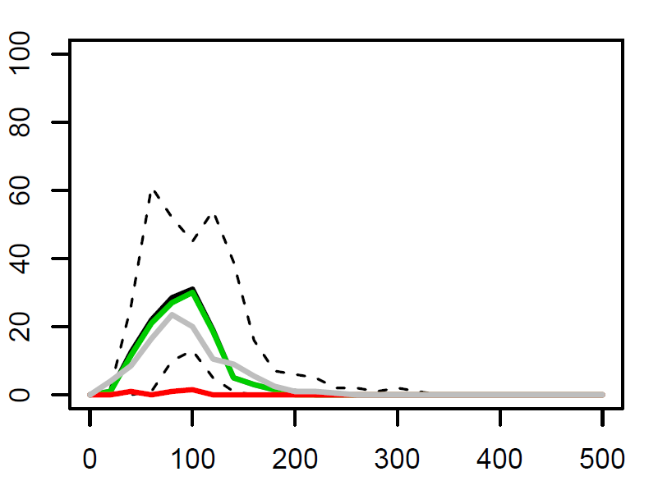
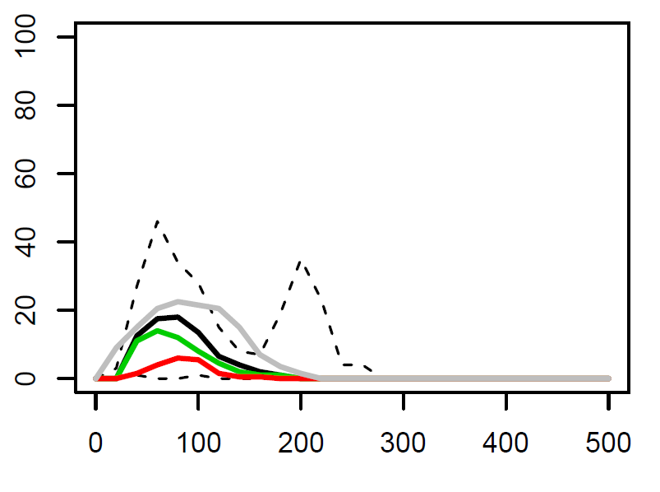
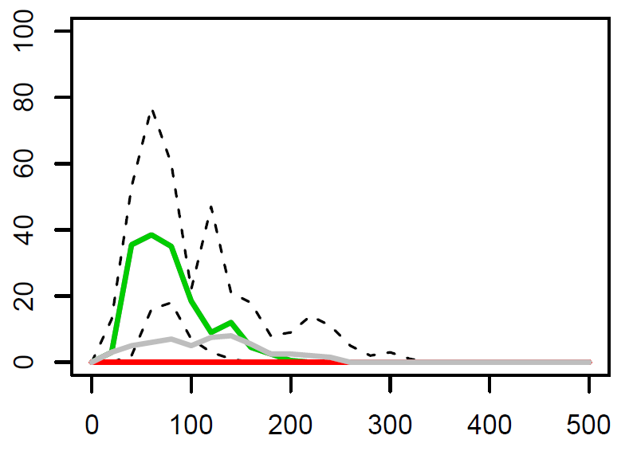
Results 1
All
Rescued
No
25
Zombified
Best situation
50
hIp1 = 0.7
hRs1 = 0.4
125

Slide 7
Understandings 1
Importance of information (No information = All zombified)
No

